Slide 1
Random Forest

Slide 2
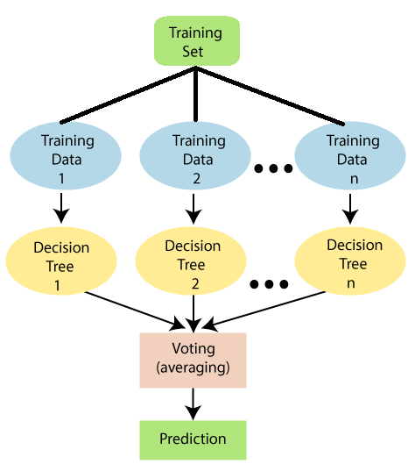
Random forest
One limitation on Decision tree algorithm is that it overfit the model that solution is provided with random forest algorithm.
Random forest classifier is powerful ML algorithm which can be use to solve classification as well as regression problems.
Random forest contains a number of decision trees on various subsets of the given dataset and takes the average to improve the predictive accuracy of that dataset. ” Instead of relying on one decision tree,
the random forest takes the prediction from each tree and based on the majority votes of predictions, and it predicts the final output.
The greater number of trees in the forest leads to higher accuracy and prevents the problem of overfitting.
We can understand working of Random forest from diagram shown in figure

Slide 3
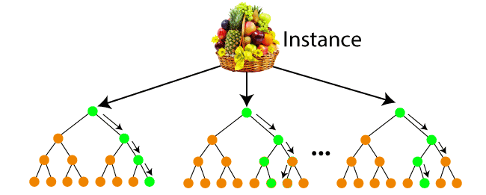
Suppose there is a dataset that contains multiple fruit images. So, this dataset is given to the Random forest classifier. The dataset is divided into subsets and given to each decision tree.
During the training phase, each decision tree produces a prediction result, and when a new data point occurs.
Default number of tree that created in sklearn is 100 but we can change it. In this example we just take three tree so we can better understand.
As we can see above tree is created on over training dataset.

Slide 4
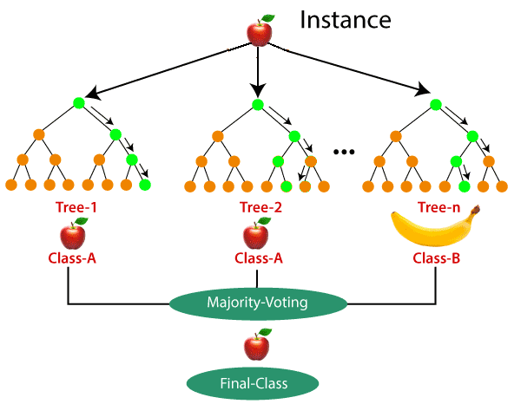
Now to understand how model predict we consider case that we apply apple data into Random forest.
Here all decision tree will try to classify input data and base on majority voting our final class value will be selected.

